Slide 1
21CSC201J DATA STRUCTURES AND ALGORITHMS UNIT-4 Topic : Introduction to Trees, Tree Traversals, Complete Binary tree and its height, Binary search trees

Slide 2
TOPICS TO BE COVERED
INTRODUCTION TO TREE
TREE TRAVERSAL
BINARY TREE

Slide 3
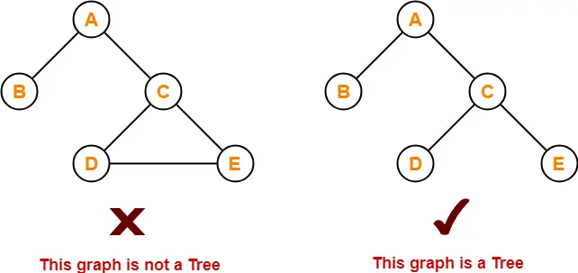
Introduction to Trees
Tree data structure may be defined as
Tree is a non-linear data structure which organizes data in a hierarchical structure and this is a recursive definition.
OR
A tree is a connected graph without any circuits.
OR
If there is one and only one path between every pair of vertices in a graph, then the graph is called a tree

Slide 4
Properties of Tree
The important properties of the tree data structure are-
There is one and only one path between every pair of vertices in a tree.
A tree with n vertices has exactly (n-1) edges.
A graph is a tree if and only if it is minimally connected.
Any connected graph with n vertices and (n-1) edges is a tree.

Slide 5
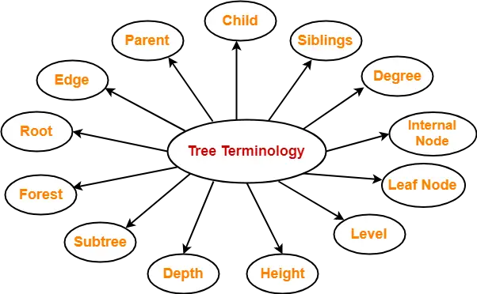
Tree Terminology
The important terms related to tree data structure are-

Slide 6
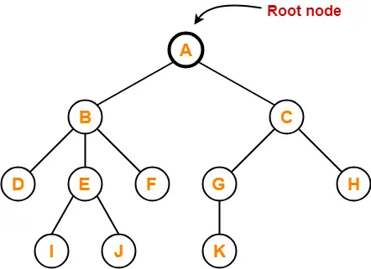
Root
The first node from where the tree originates is called as a root node.
In any tree, there must be only one root node.
We can never have multiple root nodes in a tree data structure.
Example-

Slide 7
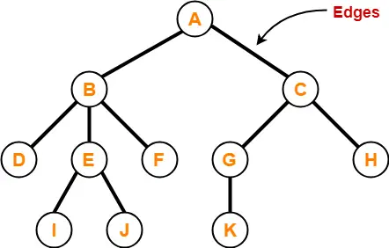
Edge
The connecting link between any two nodes is called as an edge.
In a tree with n number of nodes, there are exactly (n-1) number of edges.
Example-

Slide 8
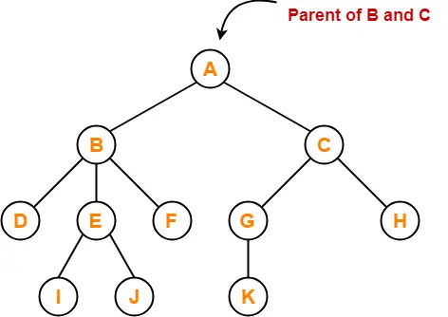
Parent
The node with a branch from it to any other node is called a parent node.
In other words, the node which has one or more children is called as a parent node.
In a tree, a parent node can have any number of child nodes.
Example-
Here
Node A is the parent of nodes B and C
Node B is the parent of nodes D, E and F
Node C is the parent of nodes G and H
Node E is the parent of nodes I and J
Node G is the parent of node K

Slide 9
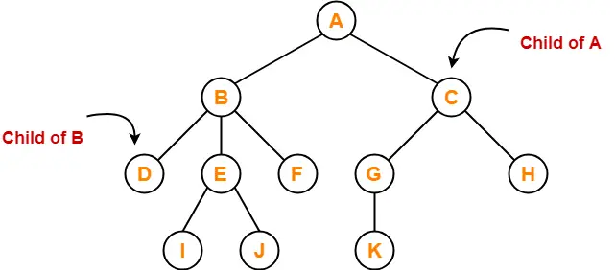
Child
The node which is a descendant of some node is called as a child node.
All the nodes except root node are child nodes.
Example-
Here,
Nodes B and C are the children of node A
Nodes D, E and F are the children of node B
Nodes G and H are the children of node C
Nodes I and J are the children of node E
Node K is the child of node G

Slide 10
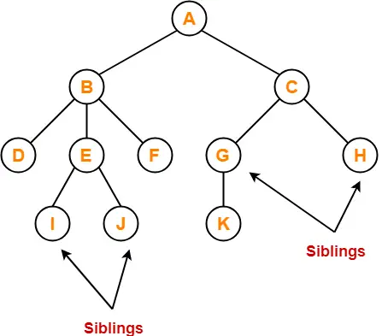
Siblings
Nodes which belong to the same parent are called as siblings.
In other words, nodes with the same parent are sibling nodes.
Example –
Here,
Nodes B and C are siblings
Nodes D, E and F are siblings
Nodes G and H are siblings
Nodes I and J are siblings

Slide 11
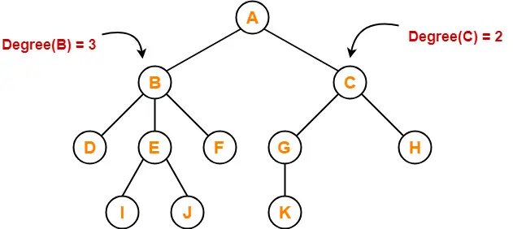
Degree
Degree of a node is the total number of children of that node.
Degree of a tree is the highest degree of a node among all the nodes in the tree.
Example-
Degree of node A = 2
Degree of node B = 3
Degree of node C = 2
Degree of node D = 0
Degree of node E = 2
Degree of node F = 0
Degree of node G = 1
Degree of node H = 0
Degree of node I = 0
Degree of node J = 0
Degree of node K = 0

Slide 12
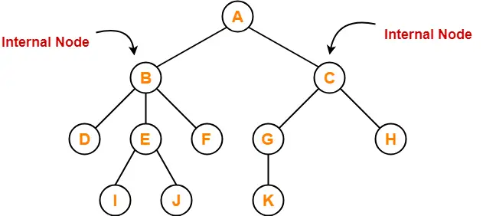
Internal Node
The node which has at least one child is called as an internal node.
Internal nodes are also called as non-terminal nodes.
Every non-leaf node is an internal node.
Example-
Here, nodes A, B, C, E and G are internal nodes.

Slide 13
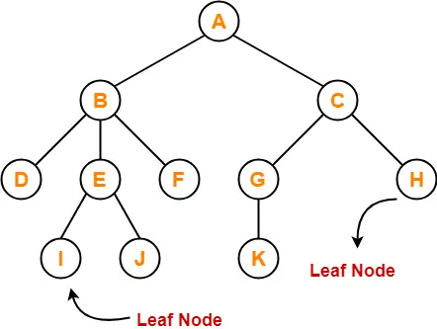
Leaf Node
The node which does not have any child is called as a leaf node.
Leaf nodes are also called as external nodes or terminal nodes.
Example-
Here, nodes D, I, J, F, K and H are leaf nodes.

Slide 14
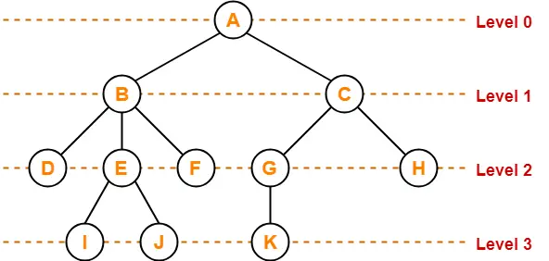
Level
In a tree, each step from top to bottom is called as level of a tree.
The level count starts with 0 and increments by 1 at each level or step.
Example

Slide 15
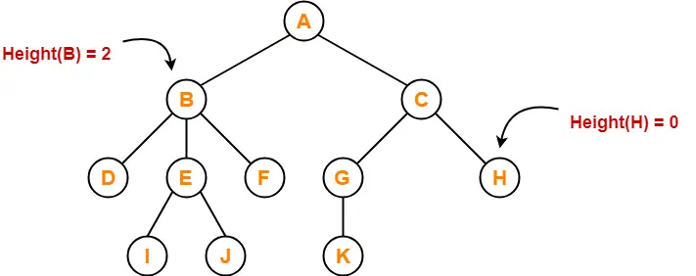
Height
Total number of edges that lies on the longest path from any leaf node to a particular node is called as height of that node.
Height of a tree is the height of root node.
Height of all leaf nodes = 0
Example -
Here,
Height of node A = 3
Height of node B = 2
Height of node C = 2
Height of node D = 0
Height of node E = 1
Height of node F = 0
Height of node G = 1
Height of node H = 0
Height of node I = 0
Height of node J = 0
Height of node K = 0

Slide 16
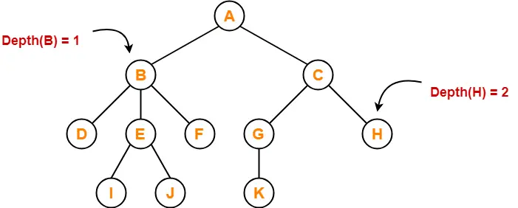
Depth
Total number of edges from root node to a particular node is called as depth of that node.
Depth of a tree is the total number of edges from root node to a leaf node in the longest path.
Depth of the root node = 0
The terms “level” and “depth” are used interchangeably.
Example-
Here,
Depth of node A = 0
Depth of node B = 1
Depth of node C = 1
Depth of node D = 2
Depth of node E = 2
Depth of node F = 2
Depth of node G = 2
Depth of node H = 2
Depth of node I = 3
Depth of node J = 3
Depth of node K = 3

Slide 17
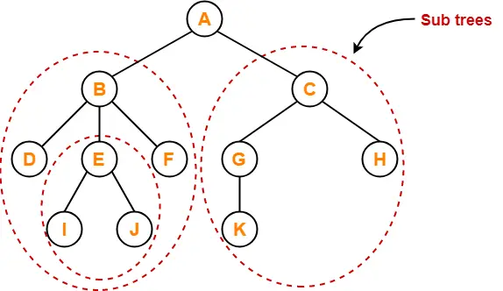
Subtree
In a tree, each child from a node forms a subtree recursively.
Every child node forms a subtree on its parent node.
Example-

Slide 18
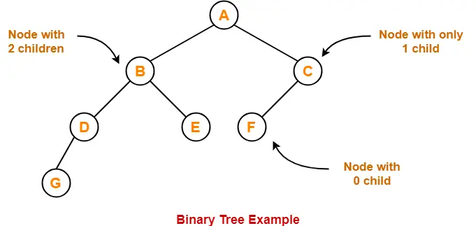
Binary Tree
Binary tree is a special tree data structure in which each node can have at most 2 children.
Thus, in a binary tree, Each node has either 0 child or 1 child or 2 children.
Example

Slide 19
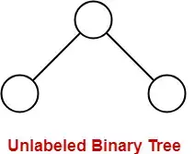
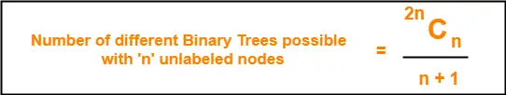
Unlabeled Binary Tree
A binary tree is unlabeled if its nodes are not assigned any label.

Slide 20
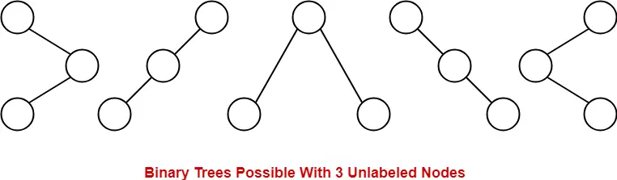
Unlabeled Binary Tree (Con.. )
Consider we want to draw all the binary trees possible with 3 unlabeled nodes.
Using the above formula, we have-
Number of binary trees possible with 3 unlabeled nodes
= 2 x 3C3 / (3 + 1)
= 6C3 / 4
= 5
With 3 unlabeled nodes, 5 unlabeled binary trees are possible.

Slide 21
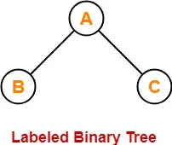
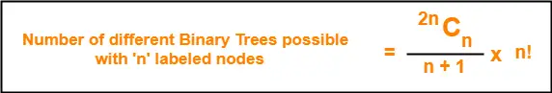
Labeled Binary Tree
A binary tree is labeled if all its nodes are assigned a label.

Slide 22
Labeled Binary Tree (Con..)
Consider we want to draw all the binary trees possible with 3 labeled nodes.
Using the above formula, we have-
Number of binary trees possible with 3 labeled nodes
= { 2 x 3C3 / (3 + 1) } x 3!
= { 6C3 / 4 } x 6
= 5 x 6
= 30
Thus,
With 3 labeled nodes, 30 labeled binary trees are possible.
Each unlabeled structure gives rise to 3! = 6 different labeled structures.

Slide 23
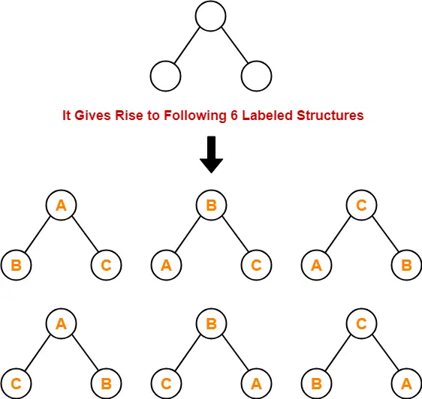
Labeled Binary Tree (Con..)
With 3 labeled nodes, 30 labeled binary trees are possible.
Each unlabeled structure gives rise to 3! = 6 different labelled structures.
Similarly,
Every other unlabeled structure gives rise to 6 different labeled structures.
Thus, in total 30 different labeled binary trees are possible.

Slide 24
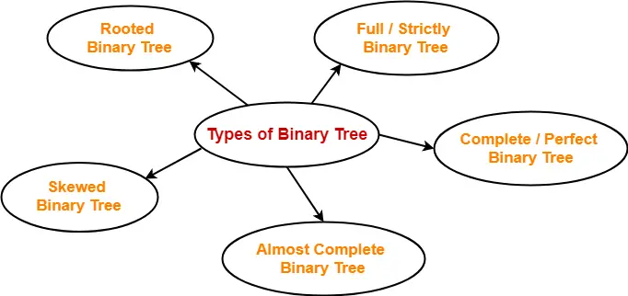
Types of Binary Trees

Slide 25
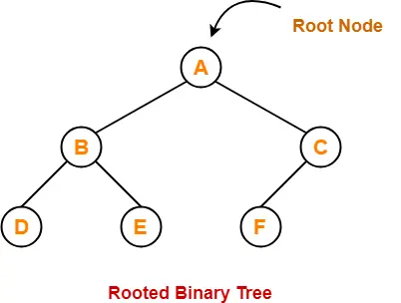
Rooted Binary Tree-
A rooted binary tree is a binary tree that satisfies the following 2 properties-
It has a root node.
Each node has at most 2 children.

Slide 26
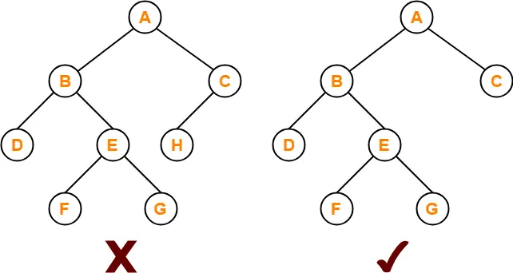
Full / Strictly Binary Tree-
A binary tree in which every node has either 0 or 2 children is called as a Full binary tree.
Full binary tree is also called as Strictly binary tree.
Here,
First binary tree is not a full binary tree.
This is because node C has only 1 child.

Slide 27
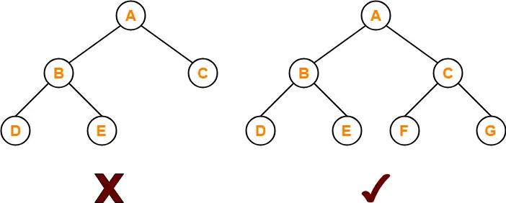
Complete / Perfect Binary Tree
A complete binary tree is a binary tree that satisfies the following 2 properties-
Every internal node has exactly 2 children.
All the leaf nodes are at the same level.
Complete binary tree is also called as Perfect binary tree.
Here,
First binary tree is not a complete binary tree.
This is because all the leaf nodes are not at the same level.

Slide 28
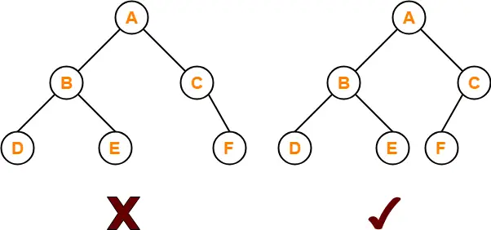
Almost Complete Binary Tree-
An almost complete binary tree is a binary tree that satisfies the following 2 properties-
All the levels are completely filled except possibly the last level.
The last level must be strictly filled from left to right.
Here,
First binary tree is not an almost complete binary tree.
This is because the last level is not filled from left to right.

Slide 29
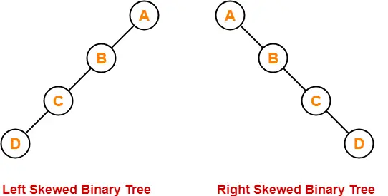
Skewed Binary Tree
A skewed binary tree is a binary tree that satisfies the following 2 properties-
All the nodes except one node has one and only one child.
The remaining node has no child.
OR
A skewed binary tree is a binary tree of n nodes such that its depth is (n-1).

Slide 30
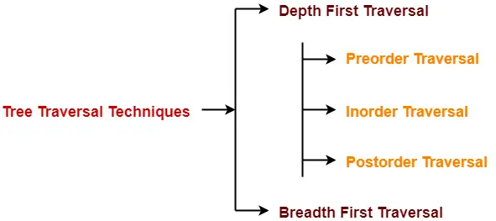
Tree Traversal
Tree Traversal refers to the process of visiting each node in a tree data structure exactly once.
Various tree traversal techniques are-

Slide 31
Depth First Traversal
Following three traversal techniques fall under Depth First Traversal-
Preorder Traversal
Inorder Traversal
Postorder Traversal

Slide 32
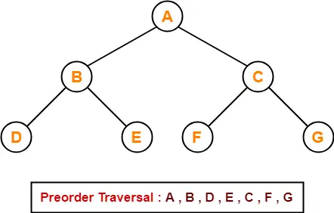
Preorder Traversal
Algorithm-
Visit the root
Traverse the left sub tree i.e. call Preorder (left sub tree)
Traverse the right sub tree i.e. call Preorder (right sub tree)
Root → Left → Right
Example-

Slide 33
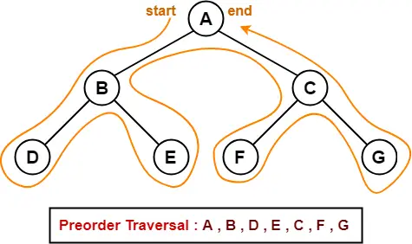
Preorder Traversal Shortcut
Traverse the entire tree starting from the root node keeping yourself to the left.
Applications-
Preorder traversal is used to get prefix expression of an expression tree.
Preorder traversal is used to create a copy of the tree.

Slide 34
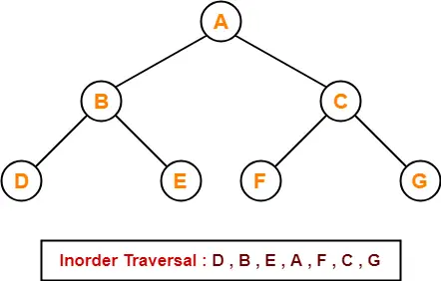
Inorder Traversal
Algorithm-
Traverse the left sub tree i.e. call Inorder (left sub tree)
Visit the root
Traverse the right sub tree i.e. call Inorder (right sub tree)
Left → Root → Right

Slide 35
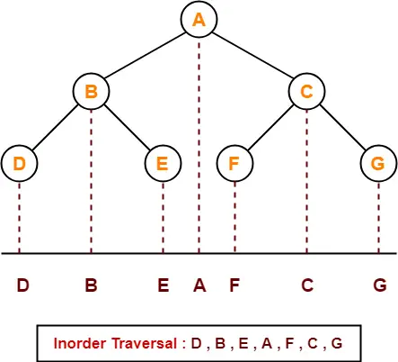
Inorder Traversal Shortcut
Keep a plane mirror horizontally at the bottom of the tree and take the projection of all the nodes.
Application-
Inorder traversal is used to get infix expression of an expression tree.

Slide 36
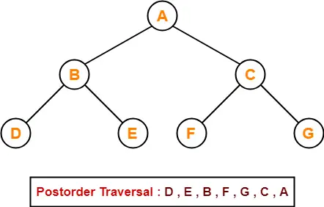
Postorder Traversal
Algorithm
Traverse the left sub tree i.e. call Postorder (left sub tree)
Traverse the right sub tree i.e. call Postorder (right sub tree)
Visit the root
Left → Right → Root

Slide 37
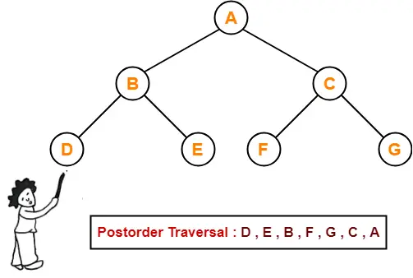
Postorder Traversal Shortcut
Pluck all the leftmost leaf nodes one by one.
Applications-
Postorder traversal is used to get postfix expression of an expression tree.
Postorder traversal is used to delete the tree.
This is because it deletes the children first and then it deletes the parent.

Slide 38
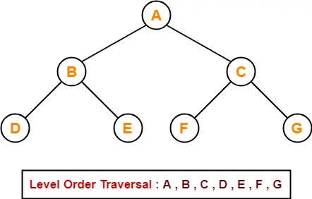
Breadth First Traversal
Breadth First Traversal of a tree prints all the nodes of a tree level by level.
Breadth First Traversal is also called as Level Order Traversal.
Application
Level order traversal is used to print the data in the same order as stored in the array representation of a complete binary tree.

Slide 39
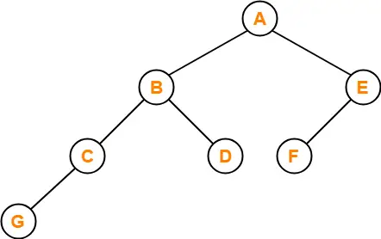
PRACTICE PROBLEMS BASED ON TREE TRAVERSAL
Problem-01: If the binary tree in figure is traversed in inorder, then the order in which the nodes will be visited is ____?

Slide 40
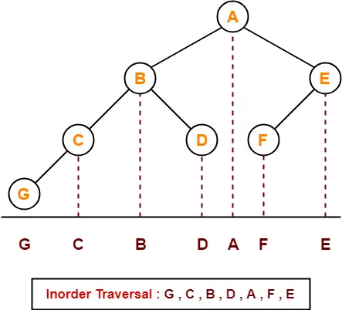
Title
Solution

Slide 41
ile
Problem-02: Which of the following sequences denotes the postorder traversal sequence of the tree shown in figure?
FEGCBDBA
GCBDAFE
GCDBFEA
FDEGCBA

Slide 42
Title
Solution:
Perform the postorder traversal by plucking all the leftmost leaf nodes one by one.
Then,
Postorder Traversal : G , C , D , B , F , E , A

Slide 43
BINARY SEARCH TREE

Slide 44
TOPICS TO BE COVERED
COMPLETE BINARY TREE AND ITS HEIGHT
BINARY SEARCH TREE
INSERTION
DELETION AND
SEARCHING

Slide 45
SRM INSTITUTE OF SCIENCE AND TECHNOLOGY
INTRODUCTION TO BINARY TREE
WHAT IS BINARY TREE?
COMPLETE BINARY TREE AND ITS HEIGHT

Slide 46
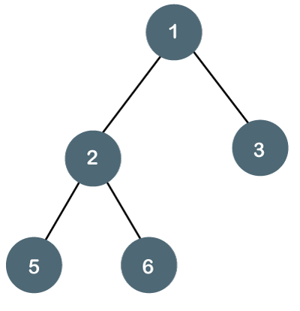
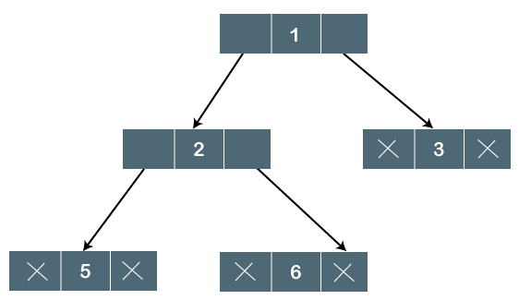
SRM INSTITUTE OF SCIENCE AND TECHNOLOGY
WHAT IS BINARY TREE?
A BINARY TREE IS A TYPE OF TREE DATA STRUCTURE IN WHICH EACH NODE CAN HAVE AT MOST TWO CHILD NODES, KNOWN AS THE LEFT CHILD AND THE RIGHT CHILD.

Slide 47

SRM INSTITUTE OF SCIENCE AND TECHNOLOGY
TYPES OF BINARY TREE
FULL BINARY TREE
COMPLETE BINARY TREE
FULL BINARY TREE
THE TREE CAN ONLY BE CONSIDERED AS THE FULL BINARY TREE IF EACH NODE MUST CONTAIN EITHER 0 OR 2 CHILDREN

Slide 48
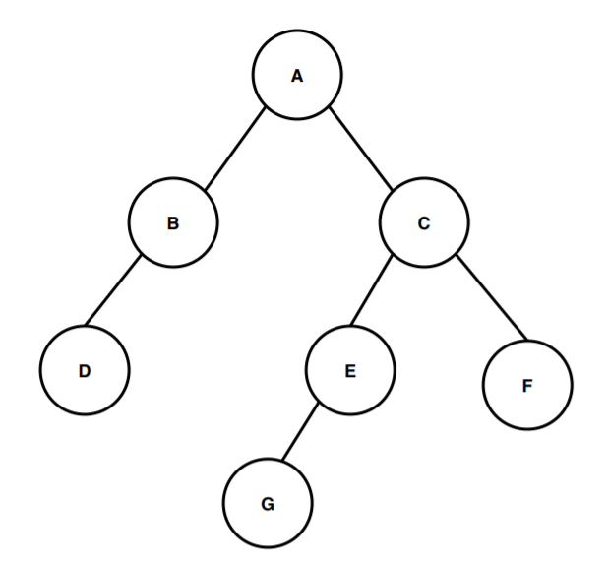
BINARY TREE
THE HEIGHT OF A NODE IN A BINARY TREE IS THE LARGEST NUMBER OF EDGES IN A PATH FROM A LEAF NODE TO A TARGET NODE
THE DEPTH OF A NODE IN A BINARY TREE IS THE TOTAL NUMBER OF EDGES FROM THE ROOT NODE TO THE TARGET NODE.
Example

Slide 49
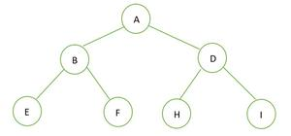
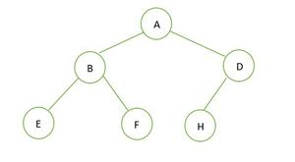
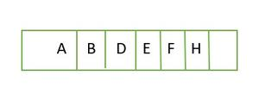
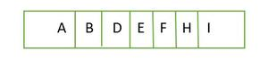
PERFECT BINARY TREE VS COMPLETE BINARY TREE:
A BINARY TREE OF HEIGHT ‘H’ HAVING THE MAXIMUM NUMBER OF NODES IS A PERFECT BINARY TREE. FOR A GIVEN HEIGHT H, THE MAXIMUM NUMBER OF NODES IS 2^{H+1}-1.
A COMPLETE BINARY TREE OF HEIGHT H IS A PERFECT BINARY TREE UP TO HEIGHT H-1, AND IN THE LAST LEVEL ELEMENT ARE STORED IN LEFT TO RIGHT ORDER.
EXAMPLE 1: EXAMPLE 2:
TREE IS N= 2^{H+1}-1 = 2²⁺¹-1 = 2³-1 = 7. 2^{H+1} – 1 = 2²⁺¹ – 1 = 2³ – 1 = 7.
COMPLETE BINARY TREE

Slide 50

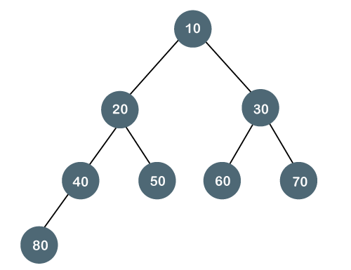
SRM INSTITUTE OF SCIENCE AND TECHNOLOGY
COMPLETE BINARY TREE
THE COMPLETE BINARY TREE IS A TREE IN WHICH ALL THE NODES ARE COMPLETELY FILLED EXCEPT THE LAST LEVEL. IN THE LAST LEVEL, ALL THE NODES MUST BE AS LEFT AS POSSIBLE. IN A COMPLETE BINARY TREE, THE NODES SHOULD BE ADDED FROM THE LEFT.

Slide 51
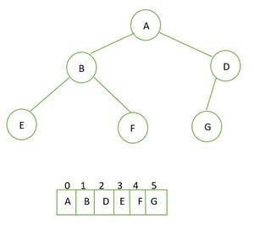
COMPLETE BINARY TREE
SRM INSTITUTE OF SCIENCE AND TECHNOLOGY
CREATION OF COMPLETE BINARY TREE
ALGORITHM
STEP 1: INITIALIZE THE ROOT WITH A NEW NODE WHEN THE TREE IS EMPTY.
STEP 2: IF THE TREE IS NOT EMPTY THEN GET THE FRONT ELEMENT
IF THE FRONT ELEMENT DOES NOT HAVE A LEFT CHILD THEN SET THE LEFT CHILD TO A NEW NODE
IF THE RIGHT CHILD IS NOT PRESENT SET THE RIGHT CHILD AS A NEW NODE
STEP 3: IF THE NODE HAS BOTH THE CHILDREN THEN POP IT FROM THE QUEUE.
STEP 4: ENQUEUE THE NEW DATA.

Slide 52
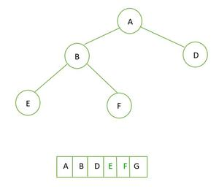
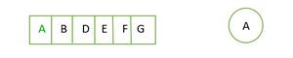
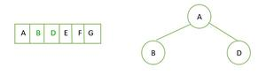
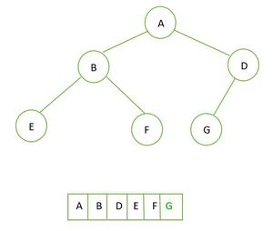
COMPLETE BINARY TREE
SRM INSTITUTE OF SCIENCE AND TECHNOLOGY
ILLUSTRATION
STEP 1 STEP 2 STEP 3
STEP 4

Slide 53
COMPLETE BINARY TREE
PROPERTIES OF COMPLETE BINARY TREE
A COMPLETE BINARY TREE IS SAID TO BE A PROPER BINARY TREE WHERE ALL LEAVES HAVE THE SAME DEPTH.
IN A COMPLETE BINARY TREE NUMBER OF NODES AT DEPTH D IS 2^{D}.
IN A COMPLETE BINARY TREE WITH N NODES HEIGHT OF THE TREE IS LOG(N+1).
ALL THE LEVELS EXCEPT THE LAST LEVEL ARE COMPLETELY FULL

Slide 54


BINARY SEARCH TREE (BST)
A BINARY SEARCH TREE FOLLOWS SOME ORDER TO ARRANGE THE ELEMENTS. IN A BINARY SEARCH TREE, THE VALUE OF LEFT NODE MUST BE SMALLER THAN THE PARENT NODE, AND THE VALUE OF RIGHT NODE MUST BE GREATER THAN THE PARENT NODE.
OPERATIONS: INSERT, SEARCH, DELETE

Slide 55




EXAMPLE OF CREATING A BINARY SEARCH TREE
SUPPOSE THE DATA ELEMENTS ARE - 45, 15, 79, 90, 10, 55, 12, 20, 50
STEP 1 - INSERT 45 STEP 2 - INSERT 15 STEP 3 - INSERT 79 STEP 4 - INSERT 90

Slide 56



EXAMPLE OF CREATING A BINARY SEARCH TREE
STEP 6 - INSERT 55 STEP 7 - INSERT 12 STEP 8 - INSERT 20

Slide 57

EXAMPLE OF CREATING A BINARY SEARCH TREE
STEP 9 - INSERT 50

Slide 58

INSERTION OF A NEW NODE IN TO A BINARY SEARCH TREE
Insert (TREE, ITEM) Step 1: IF TREE = NULL Allocate memory for TREE SET TREE -> DATA = ITEM SET TREE -> LEFT = TREE -> RIGHT = NULL ELSE IF ITEM < TREE -> DATA Insert(TREE -> LEFT, ITEM) ELSE Insert(TREE -> RIGHT, ITEM) [END OF IF] [END OF IF] Step 2: END

Slide 59

SEARCHING OF NODE IN BINARY TREE
Search (ROOT, ITEM) Step 1: IF ROOT -> DATA = ITEM OR ROOT = NULL Return ROOT ELSE IF ROOT < ROOT -> DATA Return search(ROOT -> LEFT, ITEM) ELSE Return search(ROOT -> RIGHT,ITEM) [END OF IF] [END OF IF] Step 2: END

Slide 60



DELETION OF A NEW NODE IN A BINARY TREE
Delete (TREE, ITEM) Step 1: IF TREE = NULL Write "item not found in the tree" ELSE IF ITEM < TREE -> DATA Delete(TREE->LEFT, ITEM) ELSE IF ITEM > TREE -> DATA Delete(TREE -> RIGHT, ITEM) ELSE IF TREE -> LEFT AND TREE -> RIGHT SET TEMP = findLargestNode(TREE -> LEFT) SET TREE -> DATA = TEMP -> DATA Delete(TREE -> LEFT, TEMP -> DATA) ELSE SET TEMP = TREE IF TREE -> LEFT = NULL AND TREE -> RIGHT = NULL SET TREE = NULL ELSE IF TREE -> LEFT != NULL SET TREE = TREE -> LEFT ELSE SET TREE = TREE -> RIGHT [END OF IF] FREE TEMP [END OF IF] Step 2: END
The node to be deleted is a leaf node The node to be deleted has only one child The node to be deleted has two children

